Slide 1

Online Shopper’s Purchasing Intention
Aashesh Vontivillu Nareshchand

Slide 2


Introduction
Online shopping - Made our life easy
But does the customer always have an intention to purchase whenever he visits an eCommerce website ?

Slide 3
Goal of the project
Analyze the factors that help in determining the visitor’s purchasing intention
Predict if customer has purchasing intention or not given a new set of test data
Recommend the employers in targeting customers and help in improvising the marketing strategies

Slide 4
Dataset
Consists of feature vectors belonging to 12,330 sessions
Each session would belong to a different user in a 1-year period
Aggregated pageview data and logs captured during each session
Target Variable - Purchasing Intention (Yes/No)
Imbalanced Data with target variable proportion of 85:15. Sampling needs to be implemented

Slide 5
Algorithms used
Decision Tree
Feature Importance
Random Forest
Generalize Decision Tree
AdaBoosting
Improvise Decision Tree
Naïve Bayes
Attain Conditional Probability
SVM (Radial)
Nonlinear data
Clustering
Patterns and insights from data

Slide 6




Recall Score - Metric for evaluation
Determines how well the classifier was able to predict a specific target class
Our class of interest is to find the users having the intention to purchase
Need not worry much if user who has no intention to purchase is classified as interested user as its misclassification cost is very low

Slide 7

Model Results
Naive bayes
Recall score: 0.91
1
2
Random forest
3
Recall score: 0.802
Decision tree
Recall score: 0.788
4
5
01
SVM-RBF
Ada boosting
Recall score: 0.66
Recall score: 0.795
Performed hyperparameter tuning with cross validation to select the optimal hyperparameters for each algorithm and below are the results

Slide 8
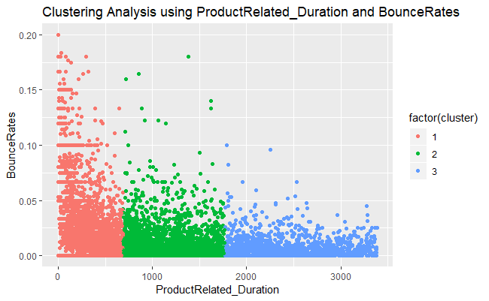
K-Means Clustering
Elbow Plot - Within Sum of Squares have reached its minimum saturation when the number of clusters was 3
BounceRate was high for observations in cluster 1 – when the time spent on the product related page was low.
BounceRate was less for observations in cluster 3 – when the time spent on the product related page was high.

Slide 9
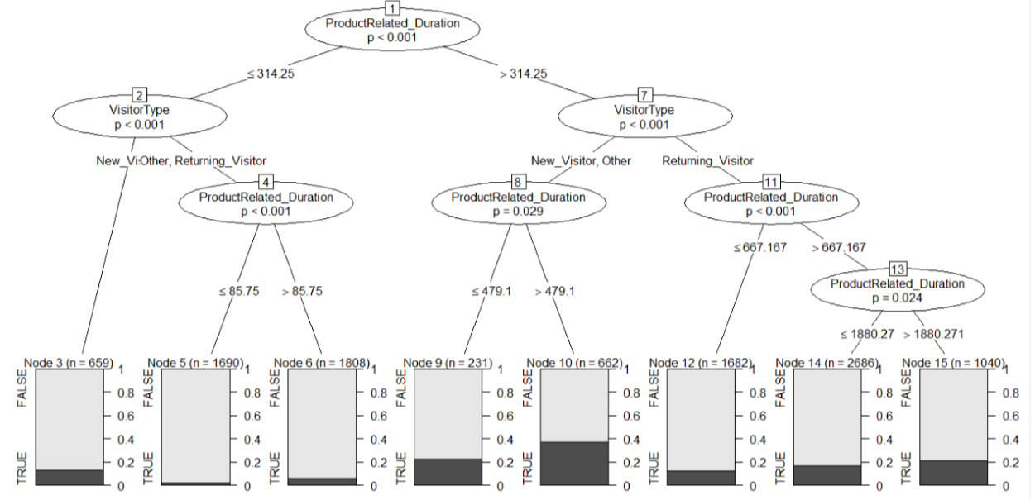
Ctree Decision Tree

Slide 10
Conclusion and Recommendations
Based on Recall Scores, Naive Bayes algorithm performed the best. But cannot be concluded it as the best model for this data as we do not account for the other factors like misclassification cost, marketing cost & average profit when the users purchases an item
Page Value – Most Important Feature from Decision Tree
NaiveBayes - Probability of purchase is 62% when user visits a non-zero page value
Target new visitors, users who spent more time on the Product Related pages and users who visiting a non-zero page value

Slide 11

Questions?

